Slide 1
The Alcanena Schools Cluster experience
Best practice

Slide 2
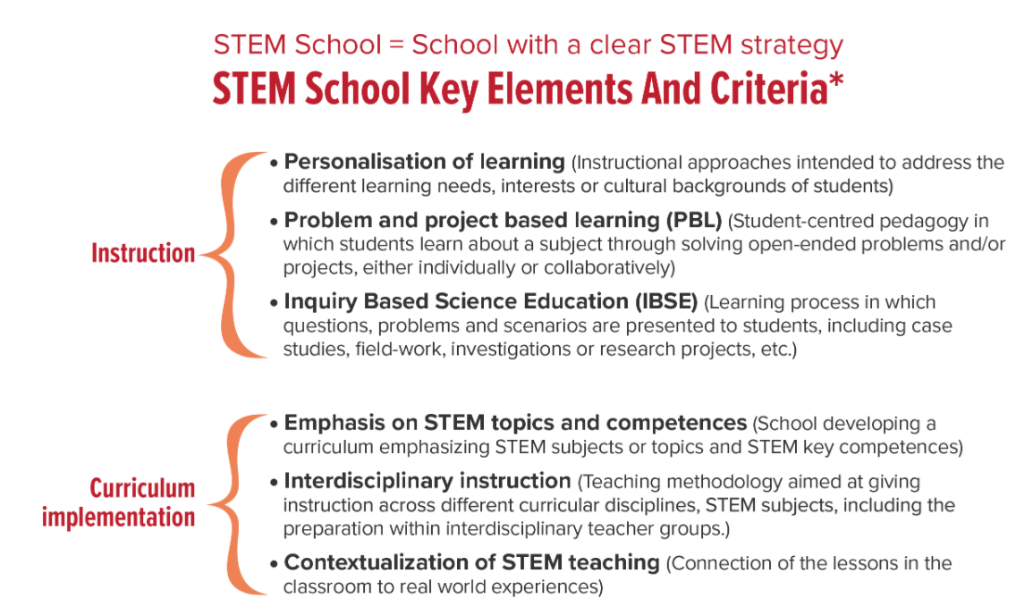
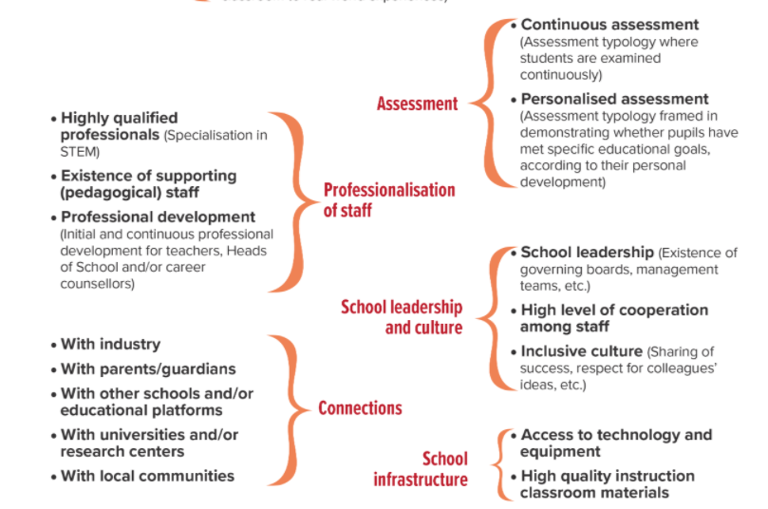
About the STEM School Label
A STEM School is defined as a school with a clear STEM strategy, characterised by different key elements and criteria.
With the STEM School Label, school representatives will be able to evaluate their school via an online self-assessment tool according to the criteria defining a STEM School. This self-assessment tool will identify required areas of development and provide training as well as resources for applicant schools to improve their STEM activities at the school level.
The objective of the project is to guide European schools in increasing young Europeans' interest and skills in STEM subjects and to provide the schools with the necessary tools to engage their students, teachers and other actors in related activities by developing an appropriate STEM strategy.
https://www.stemschoollabel.eu

Slide 3
Alcanena Schools Cluster was considered the best in Europe in science teaching, a distinction from the STEM School Label, a project funded by the European Commission, launched in 2017, which aims to support schools in the development of STEM Projects (Science, Technology, Engineering and Mathematics), through a self-assessment process based on 21 criteria. It also intends to recognize good practices, as well as promote the creation of networks between different school partners.
To receive this award, the representatives of the school needed to validate their performance in relation to STEM through an online assessment tool, which uses different criteria for the recognition of a STEM School. This self-assessment tool identifies areas with development needs and provides suggestions for resources to candidate schools in order to improve their STEM activities at school level and evolve in the attribution of certification (Competency Label, Proficiency Label and Expert Label).
The Alcanena Schools Cluster was the first STEM School Label to receive the European Proficiency Badge.
Among the various criteria for the award of this Badge are the individualization of teaching, problem-based and project-based learning, interdisciplinary teaching, whether or not continuous and individualized assessment is carried out, among other criteria, also taking into account quality of the team, leadership and school culture.
Regarding the Project based learning - Alcanena Schools Cluster has partnerships with universities and polytechnics and, in secondary education, the students travel to the Faculty of Science and Technology and participate in research projects that try to respond to local problems, such as industrial waste, fertilizers and biofuels.
The projects are curricular, they are made in the classroom and outside the classroom and they are for everyone, it is a vertical plan of experimental sciences, which goes from preschool to 12th grade.

